Slide 1

ALGORITHMS AND
FLOWCHARTS

Slide 2
Program design
Problem
Program
Algorithm
Program Design Process has 2 phases:
Problem Solving Phase
Creates an algorithm that solves the problem
Implementation (Coding) Phase
Translates the algorithm into a programming language

Slide 3
Algorithms
An algorithm is a finite set of steps defining the
solution of a particular problem.
Need not to belong one particular language
Sequence of English statements can also be
algorithm
It is not a computer program
An algorithm can be expressed in English like language called pseudo code, in a programming language or in the form of flowchart.

Slide 4
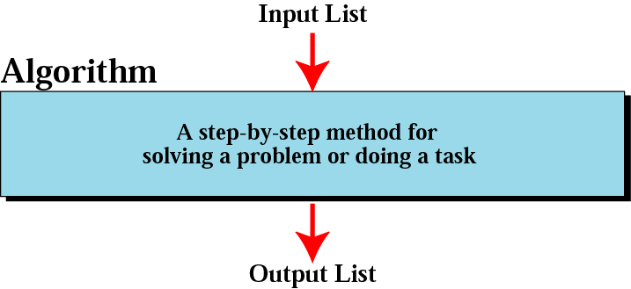
Informal definition of an algorithm

Slide 5
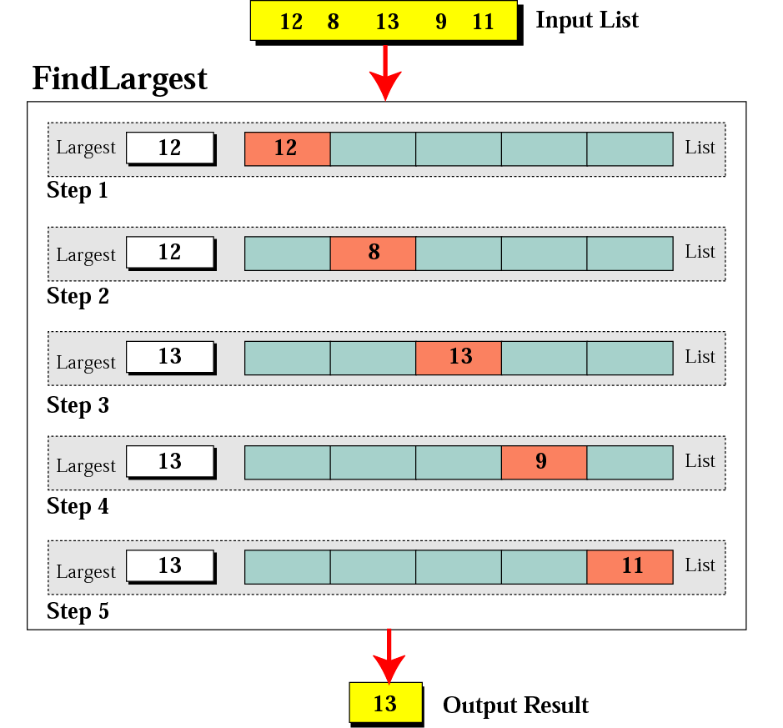
Finding the largest integer among five integers

Slide 6
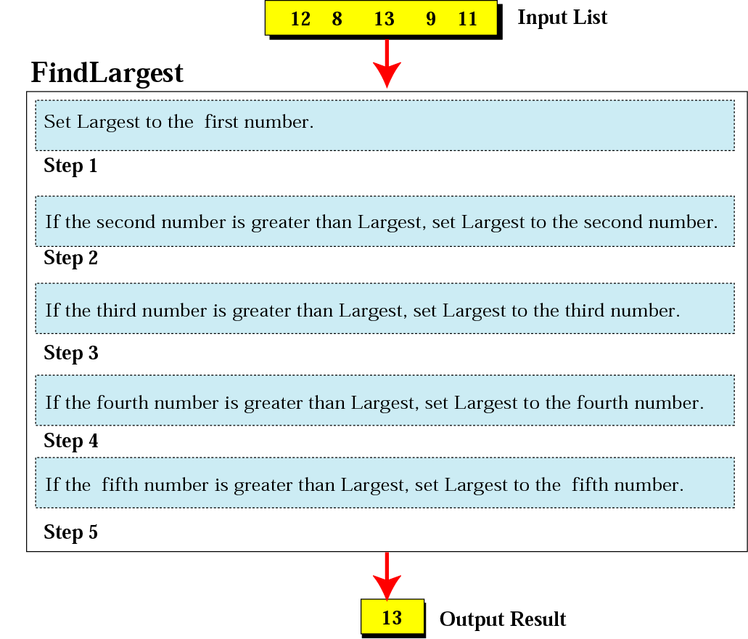
Defining actions in Find Largest algorithm

Slide 7
Algorithm Vs Program
What is the difference between an algorithm and a program?
→ a program is an implementation of an algorithm to be run on a
specific computer and operating system.
→ an algorithm is more abstract – it does not deal with machine specific details – think of it as a method to solve a problem.
What is good algorithm?
Efficient algorithms are good, we generally measure efficiency of an algorithm on the basis of:
Time: algorithm should take minimum time to execute.
Space: algorithm should use less memory.

Slide 8
Algorithm Specification
Every algorithm must satisfy the following criteria:
Input. Zero or more quantities are externally supplied.
Output. At least one quantity is produced.
Definiteness. Each instruction must be clear and unambiguous(Unique meaning).
Finiteness. An algorithm terminates in a finite number of steps.
Effectiveness. Every instruction must be basic enough to be carried out than, means not so complex.

Slide 9




Slide 10

Example 1
Write an algorithm that finds the average of two numbers
Solution:
Step 1: Start
Step 2: Declare variables num1, num2
Step 3: Read values num1 and num2.
Step 4: Add num1 and num2
Step 5: Divide result by value 2
Step 6: Display result
Step 7: Stop

Slide 11

Example 2
Write an algorithm to change a numeric grade to a pass/fail grade.
Solution:
Pass/Fail Grade
Step 1: Start
Step 2: Define one number
Step 3: if (the number is greater than or equal to 40)
then
Set the grade to “pass”
else
Set the grade to “fail” End if
Step 4: Display the grade
Step 5: Stop

Slide 12

Example 3
Write an algorithm for grading System by following method.
Marks range | Grade
>=80 | A
>=70 & <80 | B
>=60 & <70 | C
>=50 & <60 | D
<50 | F

Slide 13

Algorithm for Grading
Solution
Algorithm For Grade Input: One number
if (the number is between 80 and 100, inclusive) then
Set the grade to “A” End if
if (the number is between 70 and 79, inclusive) then
Set the grade to “B” End if
Continues on the next slide

Slide 14
if (the number is between 60 and 69, inclusive) then
Set the grade to “C” End if
if (the number is between 50 and 59, inclusive) then
Set the grade to “D” End if
If (the number is less than 50) then
Set the grade to “F” End if
Return the grade End

Slide 15
Advantages Of Algorithm
It provides the core solution to a given problem. This solution can be implemented on a computer system using any programming language of user’s choice.
It facilitates program development by acting as a design document or a blueprint of a given problem solution.
It ensures easy comprehension of a problem solution
as compared to an equivalent computer program.
It eases identification and removal of logical errors in a program.
It facilitates algorithm analysis to find out the most
efficient solution to a given problem.

Slide 16
Disadvantages Of Algorithm
In large algorithms, the flow of program control becomes difficult to track.
Algorithms lack visual representation of programming constructs like flowcharts; thus, understanding the logic becomes relatively difficult.

Slide 17
Flowchart
A graphical representation of an algorithm, often used in the design phase of programming to work out the logical flow of a program.
Visual way to represent the information flow
Make our logic more clear
Help during writing of program
Make testing and debugging easy

Slide 18
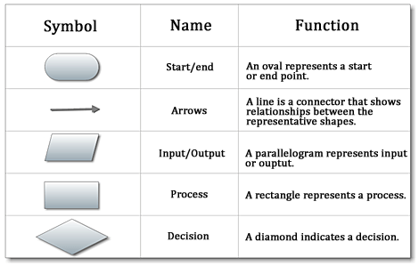

Slide 19
Flowchart or program constructs
Sequence: The order of execution, this typically refers to the order in which the code will execute. Normally code executes line by line, so line 1 then 2 then 3 and so on.
Selection: Selection, like branching, is a method of controlling the execution sequence, you can create large control blocks, using if statements testing a condition, or switch statements evaluating a variable etc to control and change the execution of the program depending on this environment and changing variables.
Iteration (Repetition): Iteration is typically used to refer to collections and arrays of variables and data. Repeating set of instruction. Counting from 1 to 10, you are iterating over the first 10 numbers. for, while, do-while loops will be implemented for iteration.

Slide 20
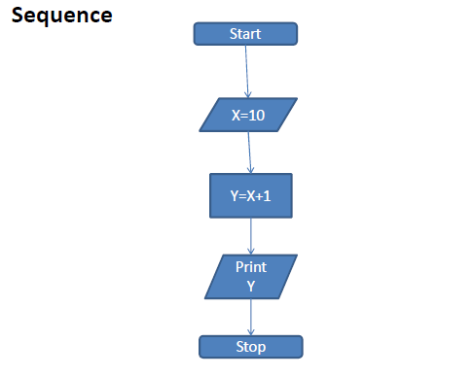
Flowchart Constructs

Slide 21
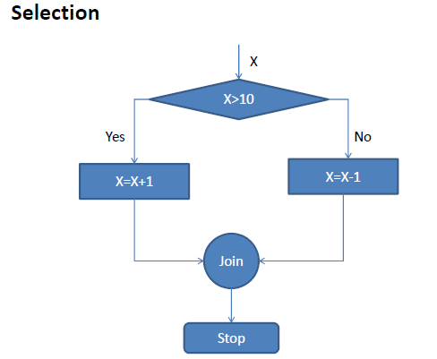
Flowchart Constructs (cont..)

Slide 22
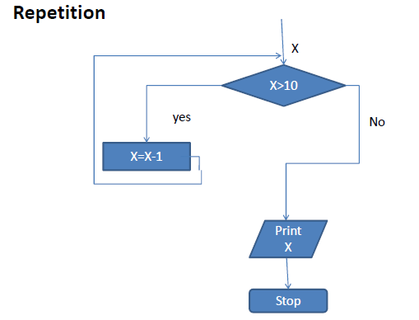
Flowchart Constructs (cont..)

Slide 23
Example-1
Write an algorithm and draw a flowchart that will read the two sides of a rectangle and calculate its area.
Algorithm
Step 1: Start
Step 2: Take Width and Length as input
Step 3: Calculate Area by Width* Length
Step 4: Print Area.
Step 5: End

Slide 24
Example-1
Step 1:
Step 2:
Step 3:
Step 4:
Step 5:
Start
Input W,L
A ← L x W Print A
End
START
Input W, L
A ← L x W
Print A
STOP

Slide 25
Example-2
Write an Pseudo code and draw a flowchart that will take marks of four subjects and calculate the average. Then if average marks are greater than 50 then print PASS otherwise print FAIL.

Slide 26
Example-2
START
Step 1: Start
Step 2: Input M1,M2,M3,M4 Step 3: AVG ← (M1+M2+M3+M4)/4
Input M1,M2,M3,M4
AVG←(M1+M2+M3+M4)/4
Step 4:
if (AVG <50) then
Print “FAIL”
N
IS
AVG<50
Y
else
Print “PASS”
Print “PASS”
Print “FAIL”
endif
Step 5: End
STOP

Slide 27
Example-3
Write an algorithm and draw a flowchart to convert the length in feet to centimeter.

Slide 28
Example-3
Flowchart
Algorithm
Step 1:
Step 2:
Start
Input Lft
START
Input Lft
Step 3: Lcm ← Lft x 30
Step 4: Print Lcm
Step 5: End
Lcm ← Lft x 30
Print Lcm
STOP

Slide 29
Example-4
Write an algorithm and draw a flowchart that will calculate the roots of a quadratic equation ax² + bx + c = 0
Hint: d = sqrt ( b² − 4ac ), and the roots are:
x1 = (–b + d)/2a and x2 = (–b – d)/2a

Slide 30
Example-4
START
Input
a, b, c
Algorithm:
Step 1: Start
Step 2: Input a, b, c
Step 3: d ← sqrt ( b×b − 4×a×c )
Step 4: x1 ← (–b + d) / (2 x a)
Step 5: x2 ← (–b – d) / (2 x a)
Step 6: Print x1, x2
Step 7: End
d ← sqrt(b x b – 4 x a x c)
x₁ ←(–b + d) / (2 x a)
X₂ ← (–b – d) / (2 x a)
Print
x₁ ,x₂
STOP

Slide 31
Flow Chart`s Limitation
For very large program, flow chart goes for many pages
Costly to draw flow charts for large program
Difficult to modify

Slide 32


